Slide 1
Our Fiduciary Duty
Protecting Elders from Financial Exploitation

Slide 2
Financial Exploitation
31 Del. C. § 3902(11) (2022):
(11) “Exploitation” means an act of forcing, compelling, or exerting undue influence over a vulnerable adult causing the vulnerable adult to act in a way that is inconsistent with relevant past behavior, or causing the vulnerable adult to perform services for the benefit of another.
Notes:
31 Del. C. § 3902(11) & (12) (2022)

Slide 3
Financial Exploitation
31 Del. C. § 3902(12) (2022):
(12) “Financial exploitation” means the illegal or improper use, control over, or withholding of the property, income, resources, or trust funds of the elderly person or the vulnerable adult by any person or entity for any person's or entity's profit or advantage other than for the elder person or the vulnerable adult's profit or advantage. “Financial exploitation” includes, but is not limited to:
Notes:
31 Del. C. § 3902(11) & (12) (2022)

Slide 4
31 Del. C. § 3902(12) (2022):
a. The use of deception, intimidation, or undue influence by a person or entity in a position of trust and confidence with an elderly person or a vulnerable adult to obtain or use the property, income, resources, or trust funds of the elderly person or the vulnerable adult for the benefit of a person or entity other than the elderly person or the vulnerable adult;
b. The breach of a fiduciary duty, including, but not limited to, the misuse of a power of attorney, trust, or a guardianship appointment, that results in the unauthorized appropriation, sale, or transfer of the property, income, resources, or trust funds of the elderly person or the vulnerable adult for the benefit of a person or entity other than the elderly person or the vulnerable adult; and
c. Obtaining or using an elderly person or a vulnerable adult's property, income, resources, or trust funds without lawful authority, by a person or entity who knows or clearly should know that the elderly person or the vulnerable adult lacks the capacity to consent to the release or use of his or her property, income, resources, or trust funds.
Notes:
31 Del. C. § 3902(11) & (12) (2022)

Slide 5
31 Del. C. § 3902(13) (2022):
(13) “Financial institution” means any of the following:
A “depository institution,” as defined in § 3(c) of the Federal Deposit Insurance Act ( 12 U.S.C § 1813(c)).
b. A “federal credit union” or “state credit union,” as defined in § 101 of the Federal Credit Union Act ( 12 U.S.C. § 1752), including, but not limited to, an institution-affiliated party of a credit union, as defined in § 206(r) of the Federal Credit Union Act ( 12 U.S.C. § 1786(r)).
c. An “institution-affiliated party,” as defined in § 3(u) of the Federal Deposit Insurance Act ( 12 U.S.C. § 1813(u)).
Notes:
31 Del. C. § 3902(11) & (12) (2022)

Slide 6
What is an institution-affiliated party?
(1) any director, officer, employee, or controlling stockholder (other than a bank holding company or savings and loan holding company) of, or agent for, an insured depository institution;
(2) any other person who has filed or is required to file a change-in-control notice with the appropriate Federal banking agency under section 7(j);

Slide 7
What is an institution-affiliated party?
(3) any shareholder (other than a bank holding company or savings and loan holding company), consultant, joint venture partner, and any other person as determined by the appropriate Federal banking agency (by regulation or case-by-case) who participates in the conduct of the affairs of an insured depository institution; and

Slide 8
What is an institution-affiliated party?
(4) any independent contractor (including any attorney, appraiser, or accountant) who knowingly or recklessly participates in--
(A) any violation of any law or regulation;
(B) any breach of fiduciary duty; or
(C) any unsafe or unsound practice,

Slide 9
Financial Exploitation
Fraud
  A stranger with no personal relationship to the victim
Financial Abuse
  Individual who knows the victim and are in positions of trust to commit crimes
  Family members, caregivers

Slide 10
Financial Fraud

Slide 11
Types of Fraud
Romance Scams
Imposter Scams
Lottery/Sweepstakes Scams
Technical Support Scams
Grandparent scams/person in need
Investment Scams
Phishing

Slide 12
Internet Crime Complaint
Over 60 stats (2023)
Total Losses
$3,427,717,654
Average Dollar Loss
$33,915
https://www.ic3.gov/Media/PDF/AnnualReport/2023_IC3ElderFraudReport.pdf
Notes:
https://www.ic3.gov/Media/PDF/AnnualReport/2023_IC3ElderFraudReport.pdf

Slide 13
Internet Crime Complaint
Over 60 stats
Complainants over 60
101,068
Lost more than $100,000
5,920
https://www.ic3.gov/Media/PDF/AnnualReport/2023_IC3ElderFraudReport.pdf
Notes:
https://www.ic3.gov/Media/PDF/AnnualReport/2023_IC3ElderFraudReport.pdf

Slide 14
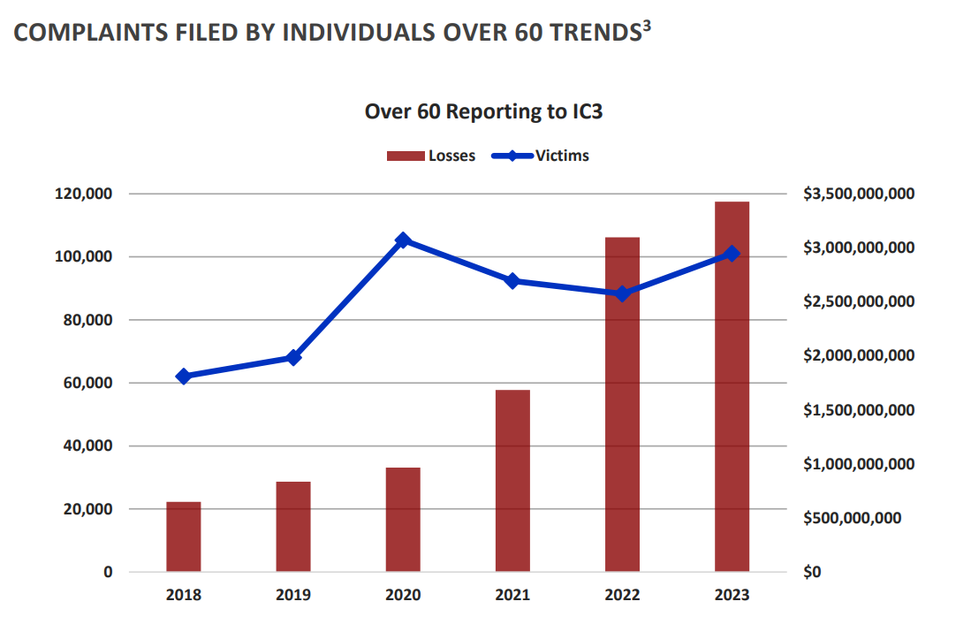
Notes:
https://www.ic3.gov/Media/PDF/AnnualReport/2023_IC3ElderFraudReport.pdf

Slide 15
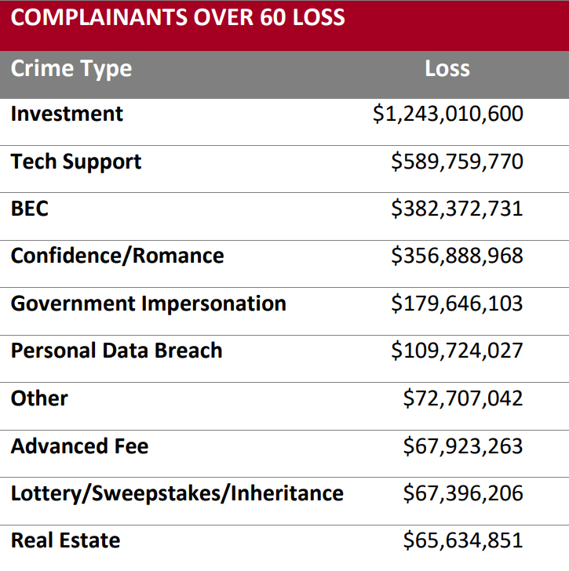
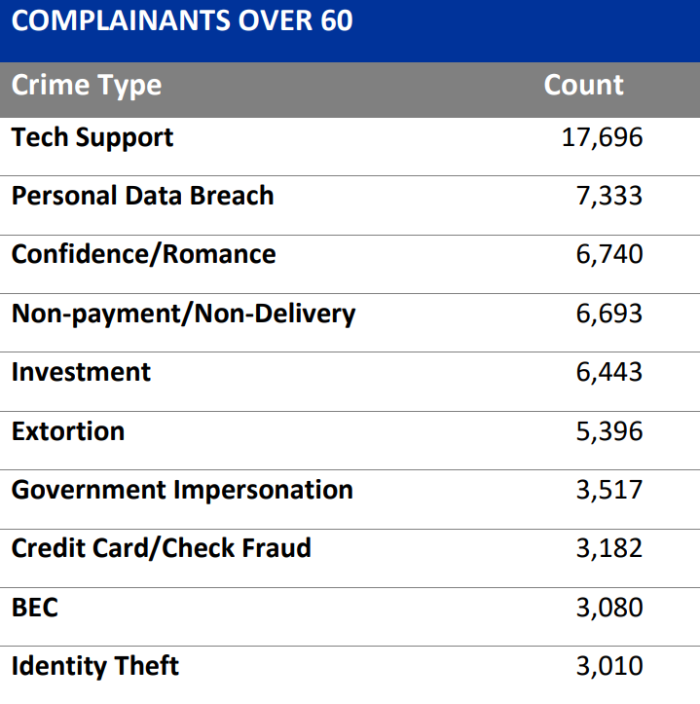
Notes:
https://www.ic3.gov/Media/PDF/AnnualReport/2023_IC3ElderFraudReport.pdf

Slide 16
What to do if fraud is suspected
Contact the originating financial institution as soon as fraud is recognized to request a recall or reversal and a Hold Harmless Letter or Letter of Indemnity.
File a detailed complaint with www.ic3.gov. It is vital the complaint contain all required data in provided fields, including banking information.
Never make any payment changes without verifying the change with the intended recipient; verify email addresses are accurate when checking email on a cell phone or other mobile device
https://www.ic3.gov/Media/PDF/AnnualReport/2023_IC3ElderFraudReport.pd
Notes:
https://www.ic3.gov/Media/PDF/AnnualReport/2023_IC3ElderFraudReport.pdf

Slide 17
Blurring the lines between fraud and abuse
Pig Butchering

Slide 18

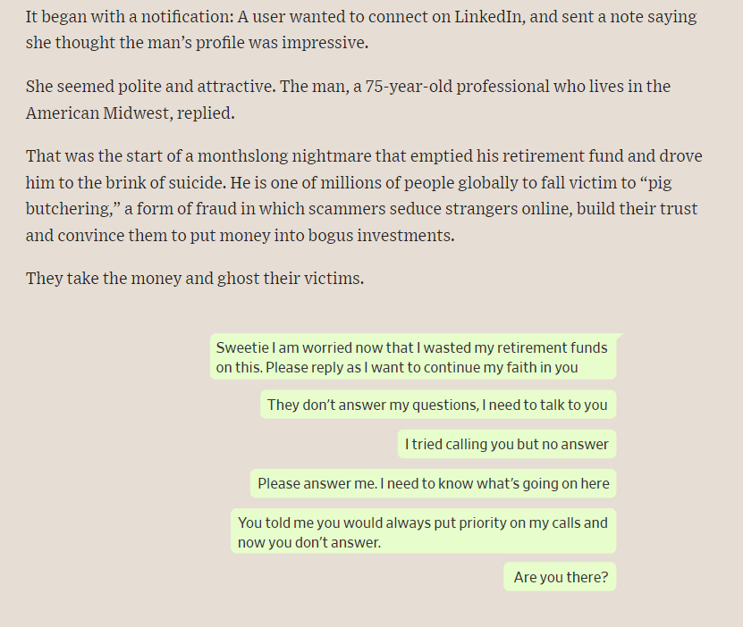
Notes:
https://www.wsj.com/arts-culture/books/online-scammer-steals-live-savings-6a510f6d

Slide 19
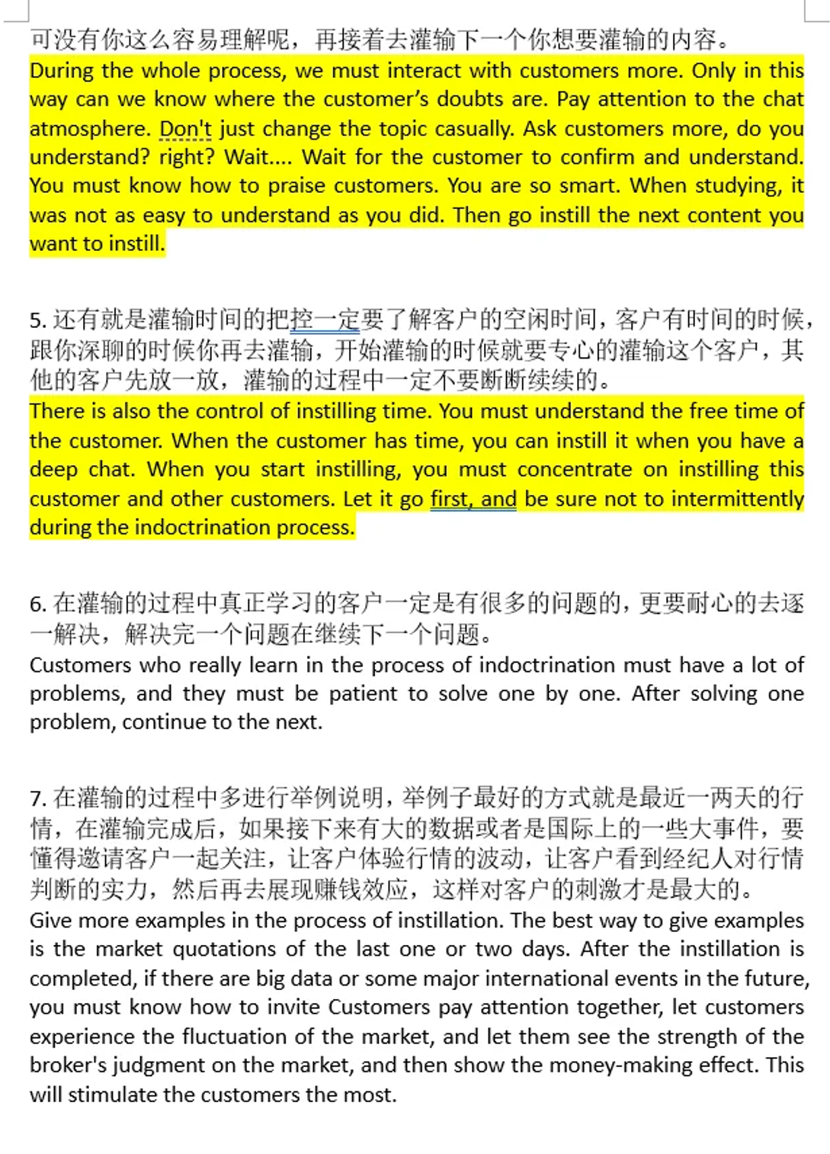

Notes:
https://www.wsj.com/arts-culture/books/online-scammer-steals-live-savings-6a510f6d

Slide 20
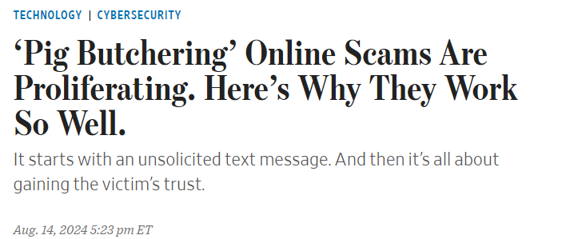
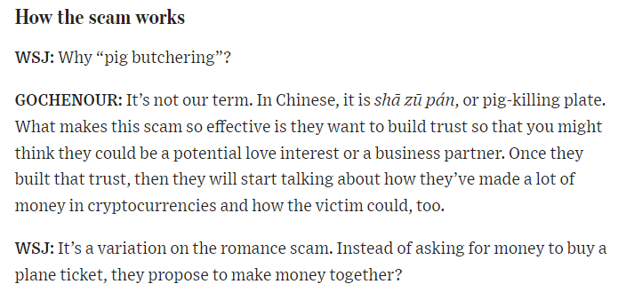
杀猪盘
Notes:
https://www.wsj.com/arts-culture/books/online-scammer-steals-live-savings-6a510f6d

Slide 21
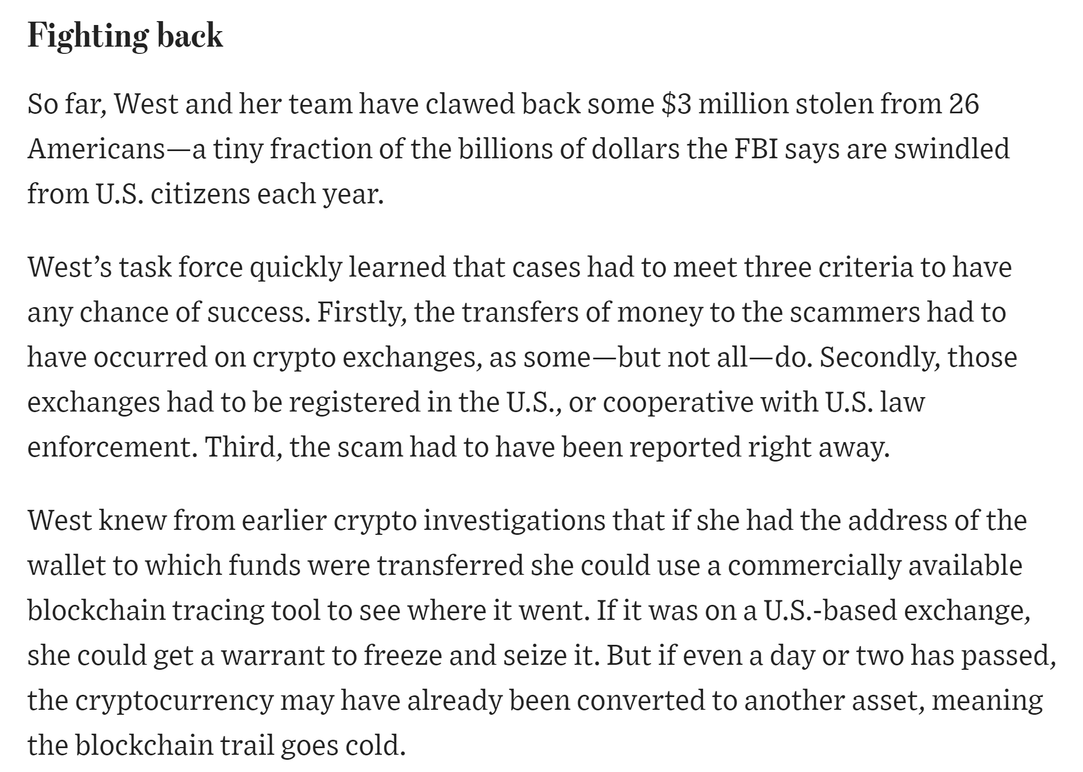
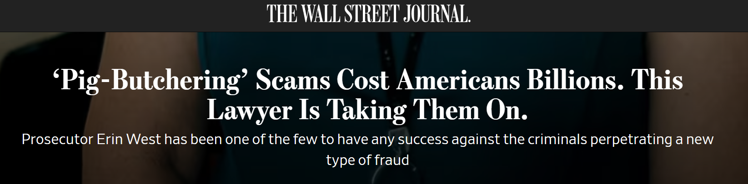
Notes:
https://www.wsj.com/arts-culture/books/online-scammer-steals-live-savings-6a510f6d

Slide 22
Financial Abuse

Slide 23
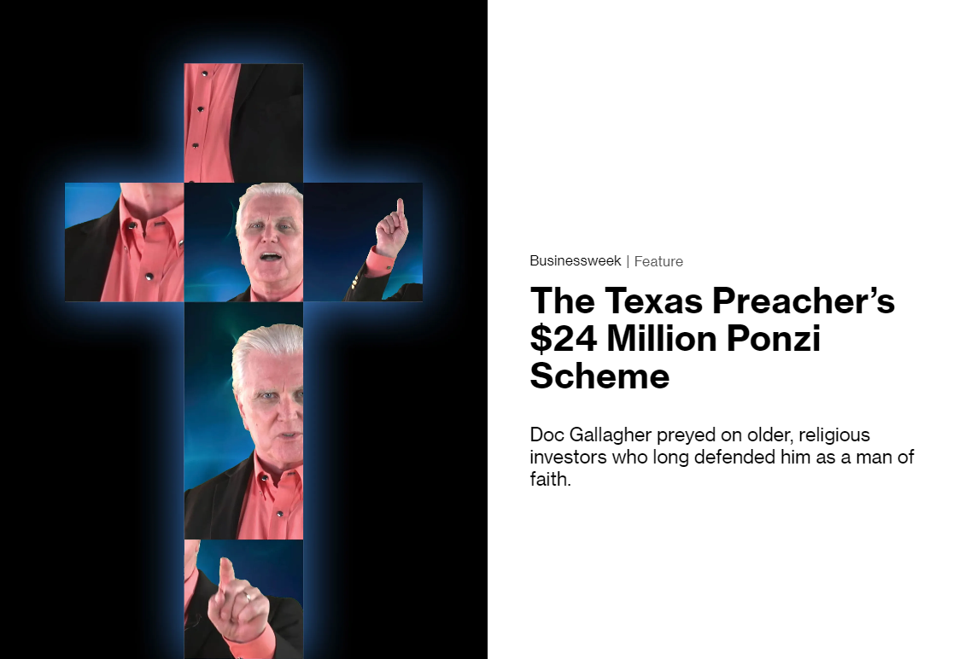
Notes:
https://www.bloomberg.com/news/features/2023-03-27/texas-preacher-doc-gallagher-stole-24-million-with-ponzi-scheme?embedded-checkout=true

Slide 24
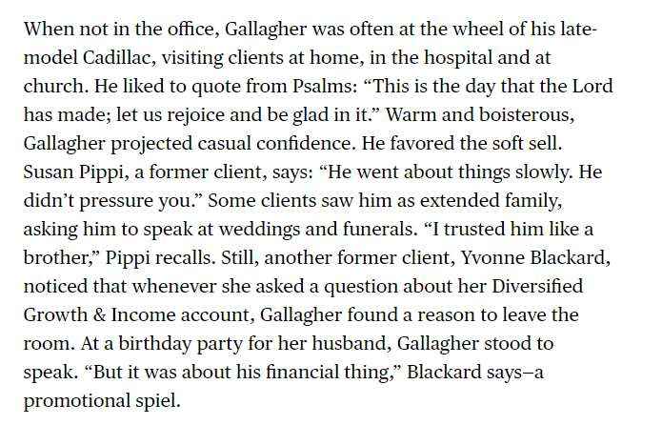
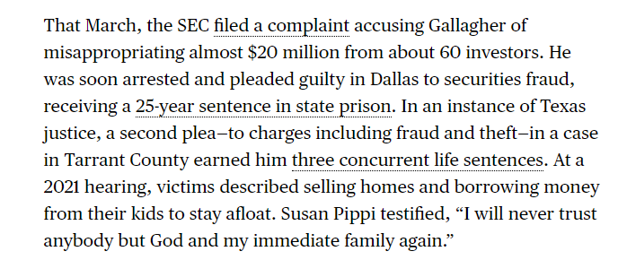
Notes:
https://www.bloomberg.com/news/features/2023-03-27/texas-preacher-doc-gallagher-stole-24-million-with-ponzi-scheme?embedded-checkout=true

Slide 25
Case Study

Slide 26
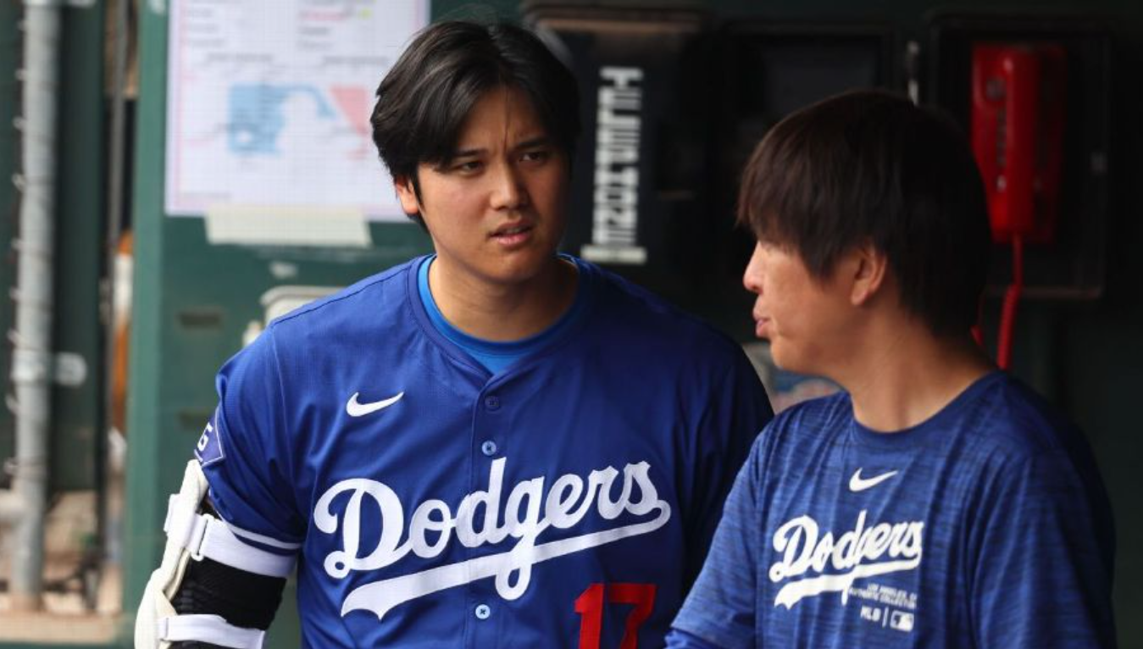
Notes:
Dodgers designated hitter Shohei Ohtani talks with interpreter Ippei Mizuhara during a spring training game in Phoenix on March 12. | USA TODAY / VIA REUTERS

Slide 27
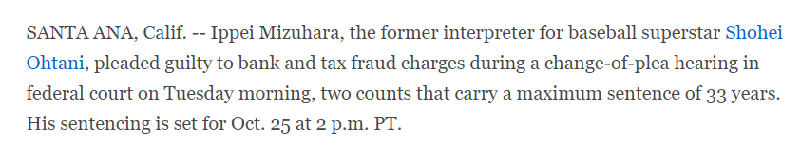
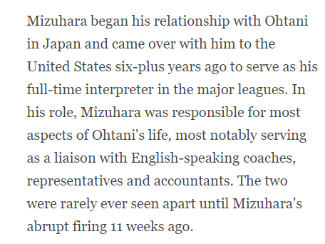
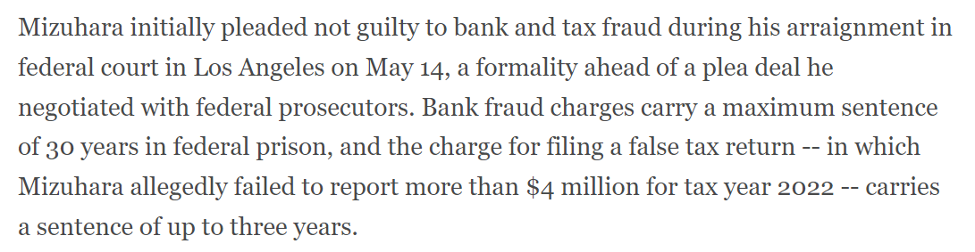
Notes:
https://www.espn.com/mlb/story/_/id/40277006/ippei-mizuhara-ex-interpreter-shohei-ohtani-pleads-guilty

Slide 28
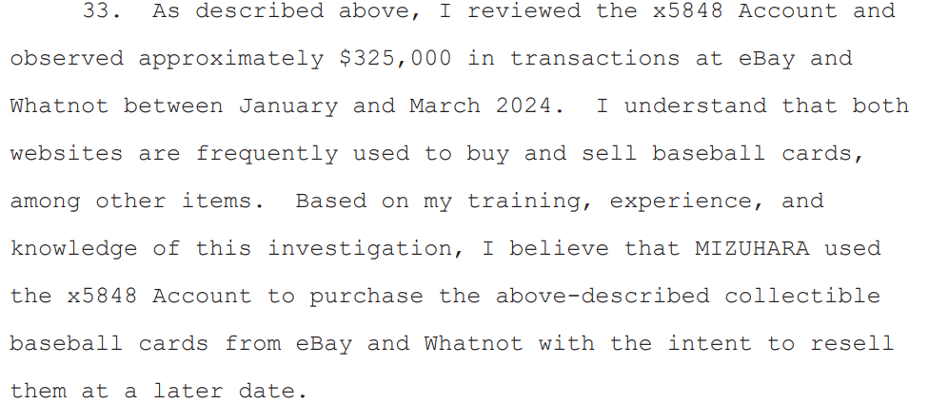
Potential Signs of Financial Exploitation
  Unusual activity in a person’s bank accounts, including large, frequent or unexplained withdrawals.
Notes:
https://www.courthousenews.com/wp-content/uploads/2024/04/ippei-mizuhara-criminal-complaint.pdf

Slide 29
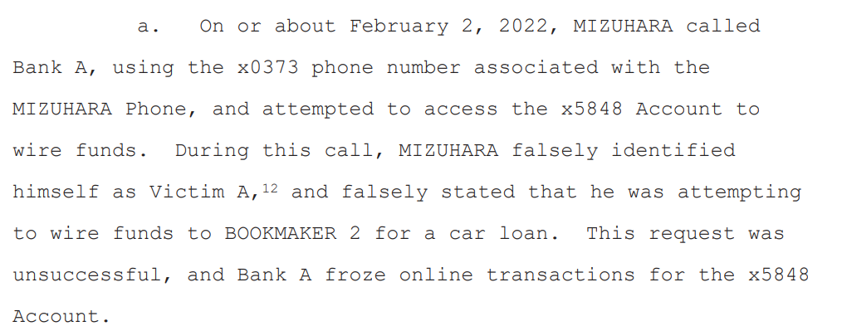
Potential Signs of Financial Exploitation
  Suspicious signatures on checks, or outright forgery.

Slide 30
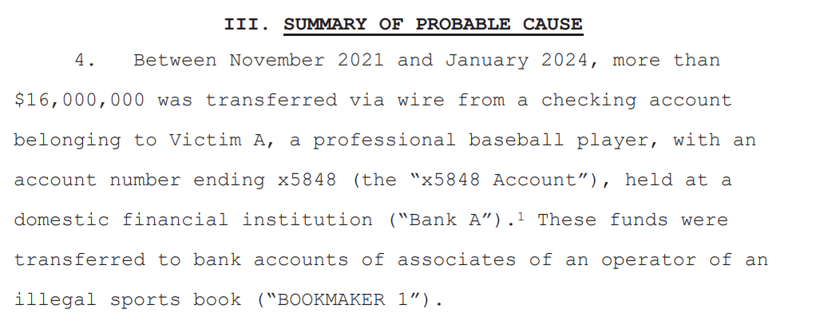
Potential Signs of Financial Exploitation
Uncharacteristic attempts to wire large sums of money.

Slide 31
Potential Signs of Financial Exploitation
New “best friends” accompanying an older person to the bank.
New powers of attorney the older person does not understand.
A caretaker, relative or friend who suddenly begins conducting financial transactions on behalf of an older person without proper documentation.

Slide 32
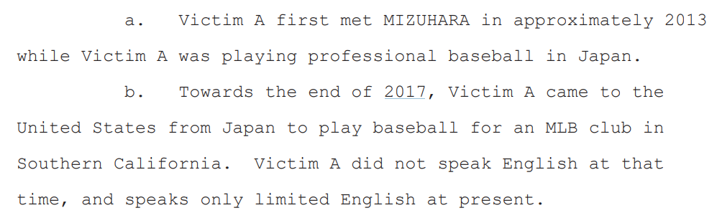
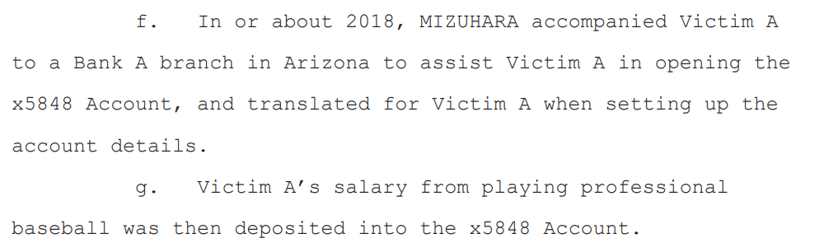

Slide 33
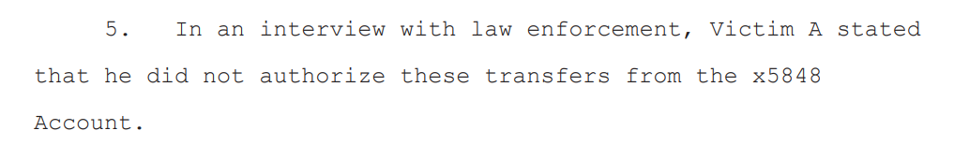
Potential Signs of Financial Exploitation
Withdrawals from bank accounts or transfers between accounts the customer cannot explain.

Slide 34
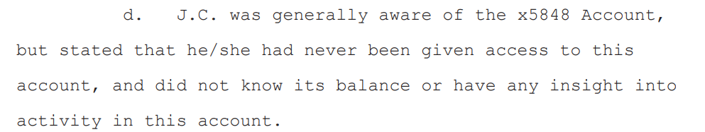
Potential Signs of Financial Exploitation
  Bank statements that no longer go to the customer’s home.

Slide 35
Potential Signs of Elder Financial Exploitation
  Unusual activity in an older person’s bank accounts, including large, frequent or unexplained withdrawals.
  ATM withdrawals by an older person who has never used a debit or ATM card.
  Changing from a basic account to one that offers more complicated services the customer does not fully understand or need.
https://www.aba.com/advocacy/community-programs/consumer-resources/protect-your-money/elderly-financial-abuse

Slide 36
Potential Signs of Elder Financial Exploitation
Withdrawals from bank accounts or transfers between accounts the customer cannot explain.
New “best friends” accompanying an older person to the bank.
Sudden non-sufficient fund activity or unpaid bills
Closing CDs or accounts without regard to penalties.
Uncharacteristic attempts to wire large sums of money.
https://www.aba.com/advocacy/community-programs/consumer-resources/protect-your-money/elderly-financial-abuse

Slide 37
Potential Signs of Elder Financial Exploitation
  Confusion, fear or lack of awareness on the part of an older customer.
  Refusal to make eye contact, shame or reluctance to talk about the problem.
  Checks written as “loans” or “gifts.”
  Bank statements that no longer go to the customer’s home.
https://www.aba.com/advocacy/community-programs/consumer-resources/protect-your-money/elderly-financial-abuse

Slide 38
Potential Signs of Elder Financial Exploitation
New powers of attorney the older person does not understand.
A caretaker, relative or friend who suddenly begins conducting financial transactions on behalf of an older person without proper documentation.
Altered wills and trusts.
Loss of Property
https://www.aba.com/advocacy/community-programs/consumer-resources/protect-your-money/elderly-financial-abuse

Slide 39
Reporting

Slide 40
Reporting
The Senior Safe Act became federal law on May 24, 2018.[1] The Senior Safe Act does not mandate any action by financial institutions and regulators. However, for financial institutions and certain eligible employees (discussed below), affiliated persons, and associated persons (“eligible employees”), who satisfy its requirements, the Senior Safe Act provides immunity from liability in any civil or administrative proceeding for reporting potential exploitation of a senior citizen. As an example, this immunity can be helpful when a firm wants to report potential exploitation but fears that the report could violate a privacy requirement
https://www.investor.gov/senior-safe-act-fact-sheet

Slide 41
Reporting
The Senior Safe Act provides that, to receive the immunity provided by the Act, the training must: (1) instruct any individual attending the training on how to identify and report the suspected exploitation of a senior citizen internally and, as appropriate, to government officials or law enforcement authorities, including common signs that indicate the financial exploitation of a senior citizen; (2) discuss the need to protect the privacy and respect the integrity of each individual customer of the covered financial institution; and (3) be appropriate to the job responsibilities of the individual attending the training.
Notes:
https://www.kitces.com/blog/steve-starnes-diminished-capacity-dementia-senior-safe-act-finra-rule-2165-4512-trusted-contact-person/

Slide 42
Reporting
The Senior Safe Act only provides immunity for contacting a “covered agency,” such as a Federal or state regulator, FINRA, or a state or local Adult Protective Services agency. It explicitly omits protection for conversations with third parties.
Trusted friends or family members may be ideally positioned to team up with you and your client as your client’s condition deteriorates. This means the Senior Safe Act alone isn’t enough to support financial advisors who want to involve other family members as a first (or alternative) line of defense for clients with diminishing capacity.
A “senior citizen” for purposes of the Senior Safe Act is “an individual who is not younger than 65 years of age.”
https://www.kitces.com/blog/steve-starnes-diminished-capacity-dementia-senior-safe-act-finra-rule-2165-4512-trusted-contact-person/
Notes:
https://www.kitces.com/blog/steve-starnes-diminished-capacity-dementia-senior-safe-act-finra-rule-2165-4512-trusted-contact-person/

Slide 43
Delaware Title 11 § 201
(10) “Elderly person” means any person who is 62 years of age or older. Thus, the terms “elderly person” and “person who is 62 years of age or older” shall have the same meaning as used in this Code or in any action brought pursuant to this Code.

Slide 44
Delaware title 31 § 3910
Duty to Report
(a) Any person having reasonable cause to believe that an adult person is impaired or incapacitated as defined in § 3902 of this title and is in need of protective services as defined in § 3904 of this title shall report such information to the Department in the manner and format published by the Department.

Slide 45
Delaware title 31 § 3910
Duty to Report
(c) If an employee of a financial institution who has direct contact with an elderly person has reasonable cause to believe that such elderly person who is an account holder may be subject to past, current or attempted financial exploitation, that employee shall follow any internal written policy, program, plan or procedure adopted by the financial institution for the purpose of establishing protocols for the reporting of past, current or attempted financial exploitation. Said policies, programs, plans or procedures shall require written reporting to the Department, in the format published by the Department, by the earlier of the date on which the financial institution completes its investigation or 5 business days after the bank identifies a suspicious transaction pursuant to the policies, programs, plans or procedures adopted by the financial institution

Slide 46
Delaware title 31 § 3910
Duty to Report (c) continued
(c) Such policies, programs, plans or procedures may, in addition, allow reporting to agencies such as the Delaware Department of Justice or the Federal Trade Commission. In addition, said institution shall be empowered to place a hold on a proposed transaction for a period of 10 business days following the filing of the report. The proposed transaction can be held another 30 business days at the request of an investigating federal or state agency or if the financial institution has not heard from either the Department or the Delaware Department of Justice, or the financial institution may seek injunctive relief from a court of competent jurisdiction.

Slide 47
Delaware title 31 § 3910
Duty to Report (d)
(d) Any person or entity participating in good faith in reporting or holding or not holding a transaction pursuant to this chapter shall have immunity from any liability, civil, administrative, or criminal that might otherwise exist as a result of reporting or holding or not holding the transaction.
(e) Unless a hold is requested by the Department or the Delaware Department of Justice, a financial institution is not required to hold a transaction when provided with information alleging that financial exploitation may have occurred, may have been attempted, or is being attempted, but may use its discretion to determine whether or not to refuse to hold a transaction based on the information available to the financial institution.

Slide 48
Whom should reports be made?
Reports should be made to Adult Protective Services within 24 hours by calling 1-888-277-4302 (1-888-APS-4302) or by using the Adult Protective Services Online Submission Form.
Financial institutions only: To make a referral to APS related to suspected financial exploitation, complete the Report of Suspected Financial Exploitation Form

Slide 49
Fraud in the Future?

Slide 50
How Generative AI Maybe Used for Fraud
  Deep Fakes
Artificially created videos or audio recordings, called deepfakes, are designed to mimic real people. They are often used to trick individuals into believing false information and unwittingly participate in fraudulent transactions.
Notes:
https://fraud.net/n/the-growing-threat-of-generative-ai-fraud-in-banking-finance/
https://medium.com/@todasco/deep-fakes-for-all-the-proliferation-of-ai-voice-cloning-ecee0a461dac

Slide 51
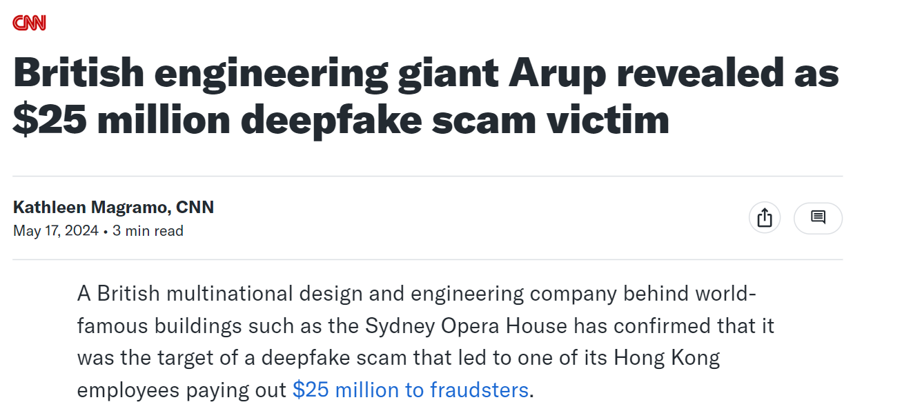
Generative AI Fraud – Deep Fakes
Notes:
https://finance.yahoo.com/news/british-engineering-giant-arup-revealed-030558740.html

Slide 52
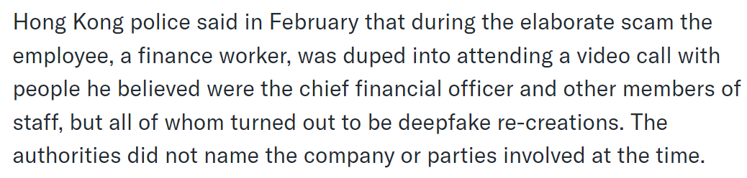
Generative AI Fraud – Deep Fakes
Notes:
https://fraud.net/n/the-growing-threat-of-generative-ai-fraud-in-banking-finance/
https://medium.com/@todasco/deep-fakes-for-all-the-proliferation-of-ai-voice-cloning-ecee0a461dac

Slide 53
Generative AI Fraud – Deep Fakes
With advances in AI, mass amounts of training data are no longer required. E.g. Play.HT only needs 30 seconds of data to create a model that can mimic a person’s voice
Notes:
https://fraud.net/n/the-growing-threat-of-generative-ai-fraud-in-banking-finance/
https://medium.com/@todasco/deep-fakes-for-all-the-proliferation-of-ai-voice-cloning-ecee0a461dac

Slide 54
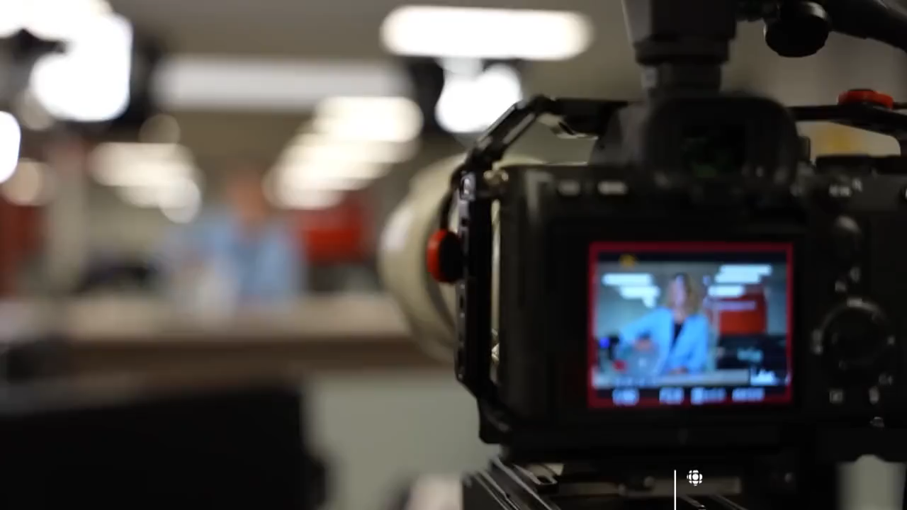
Deep Fake – Alternate Reality

Slide 55
How Generative AI Maybe Used for Fraud
AI-Enabled Phishing – Fraudsters use machine learning algorithms to create phishing emails, texts, or messages that mimic legitimate communications from banks or financial institutions. These AI-generated messages can trick individuals into disclosing confidential information or downloading malware, allowing criminals to access and steal financial data.
Document Forgery – This involves using generative AI to create or alter documents, such as bank statements, audit reports, and financial records. These AI-generated documents appear authentic, making it difficult for financial institutions to detect and verify their legitimacy.
Notes:
https://fraud.net/n/the-growing-threat-of-generative-ai-fraud-in-banking-finance/
https://medium.com/@todasco/deep-fakes-for-all-the-proliferation-of-ai-voice-cloning-ecee0a461dac

Slide 56
Stay Vigilant

Slide 57
Email Received, Aug 19 10:09am
From: John Smith <JohnSmith@johnsmith.com> (email changed to protect identity)
Date: Mon, Aug 19, 2024 at 10:09 AM
Subject: Transfer
To: Operations <operations@prudentinvestors.com>
Good morning,
I hope all is well with you!
Please email me a PDF of the form needed to update the bank account information.
Also, i need to withdraw some funds from my investment account.
Regards,
430 842-0583

Slide 58
Internal Email, Aug 19, 10:42am
I just received this email from John Smith(maybe). I have a feeling his email may have been hacked, so I tried calling both his office and cell and he didn't pick up. If you receive an email from him today, I recommend that you don't reply to it.
It may be legitimate, but the phone doesn't match what we have on file and he asked me to send a PDF rather than DocuSign.
I'll let you know when I hear from him.
Operations

Slide 59
Internal Email, Aug 19, 2:13pm
I just spoke to John and he didn't send the email. He confirmed that the address showing on the email is his, so he said he will work on the issue at his end.
Please DO NOT take any action on an email from John without a verbal confirmation.
Operations

Slide 60

Thank you
Jared Ong, Jeremy Lau
Prudent Investors
www.prudentinvestors.com

Slide 61
Disclosure
The views expressed represent the opinion of Prudent Investors. The views are subject to change and are not intended as a forecast or guarantee of future results. This material is for informational purposes only. It does not constitute investment advice and is not intended as an endorsement of any specific investment. Stated information is derived from proprietary and non-proprietary sources that have not been independently verified for accuracy or completeness. While Prudent believes the information to be accurate and reliable, we do not claim or have responsibility for its completeness, accuracy, or reliability. Statements of future expectations, estimates, projections, and other forward-looking statements are based on available information and Prudent’s view as of the time of these statements. Accordingly, such statements are inherently speculative as they are based on assumptions that may involve known and unknown risks and uncertainties. Actual results, performance or events may differ materially from those expressed or implied in such statements. Investing in equity securities involves risks, including the potential loss of principal. While equities may offer the potential for greater long-term growth than most debt securities, they generally have higher volatility.
International investments may involve risk of capital loss from unfavorable fluctuation in currency values, from differences in generally accepted accounting principles, or from economic or political instability in other nations. Past performance is not indicative of future results.

